Slide 2






















Slide 3












Slide 4







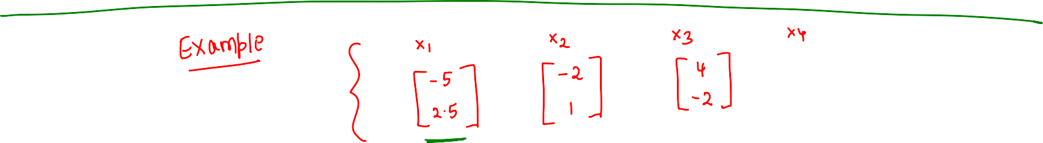







Slide 5



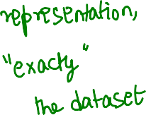





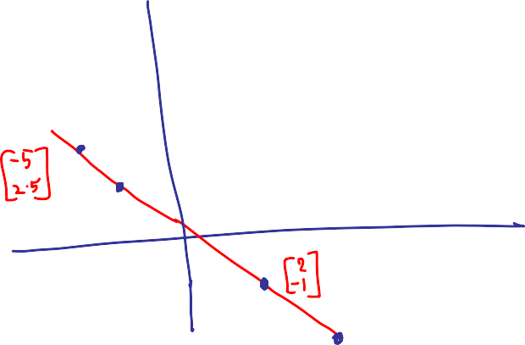







Slide 6





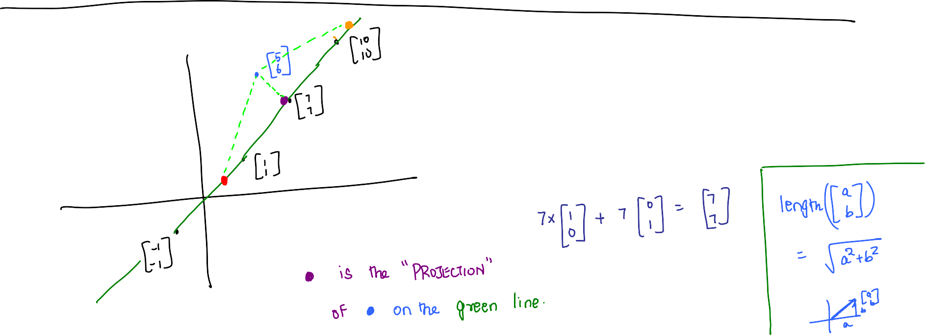



Slide 7
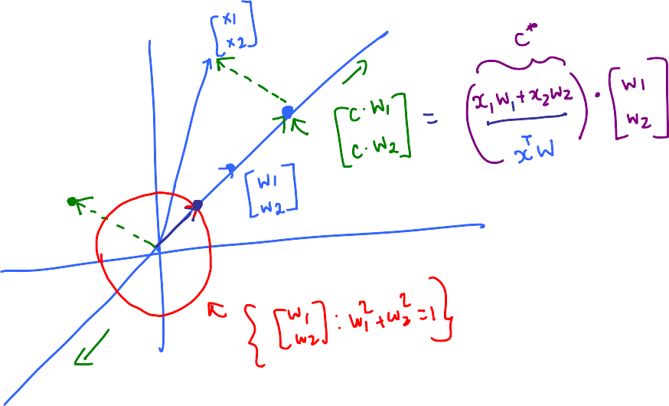


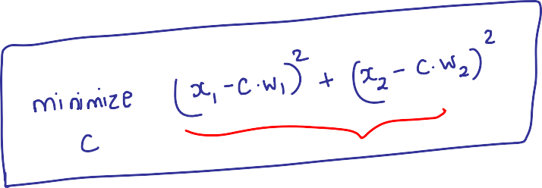



Slide 8


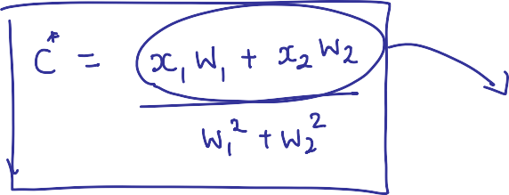







Slide 9















Slide 10



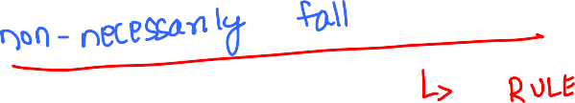


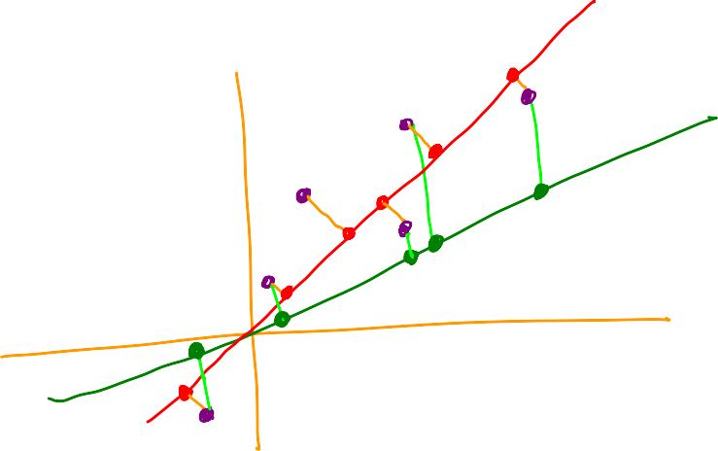

Slide 11


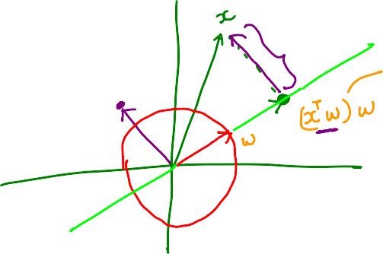







Slide 12





















Slide 13













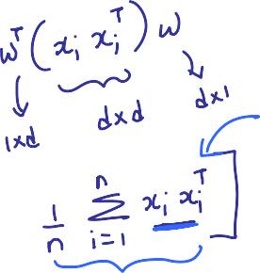





Slide 14
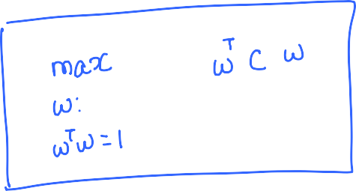
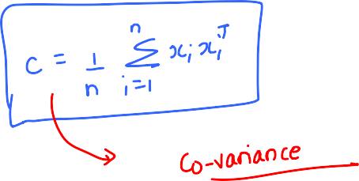








Slide 15
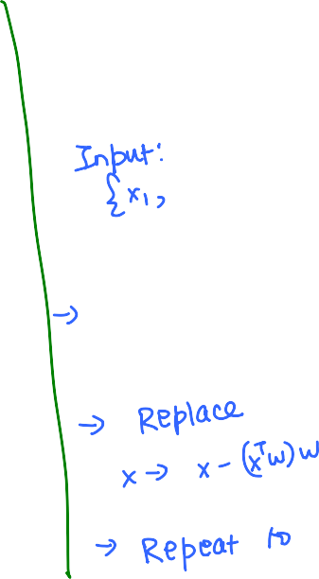


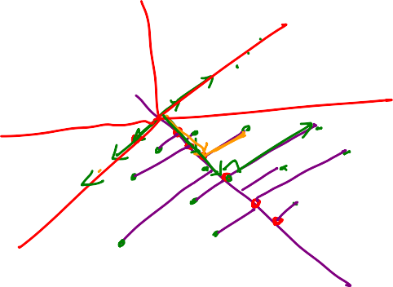







Slide 16





























Slide 17



























Slide 18
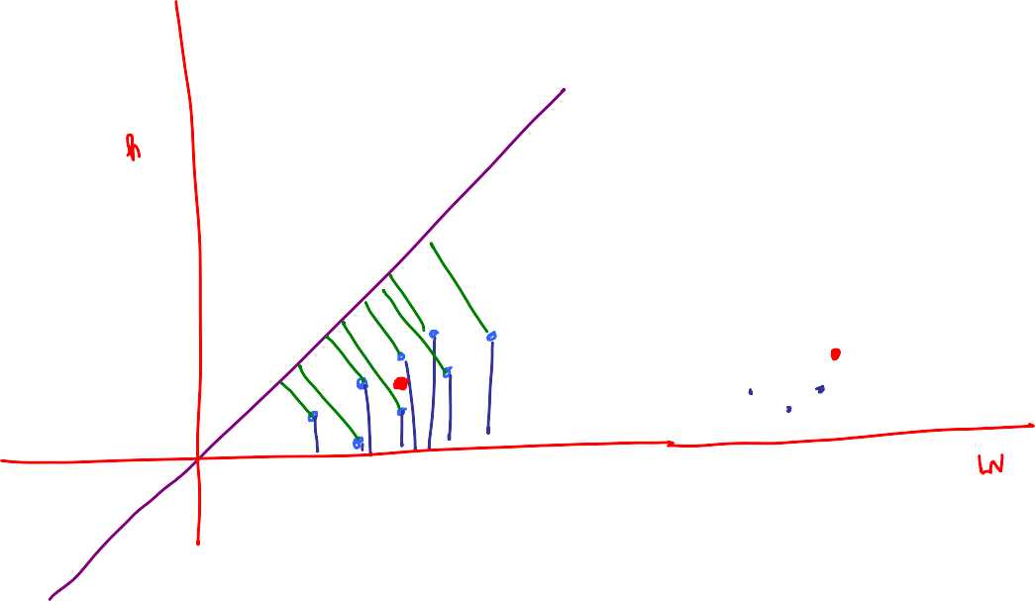






Slide 19



















Slide 20
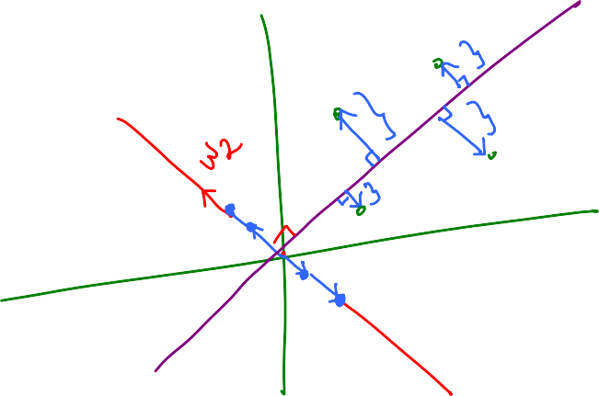









Slide 21






























Slide 22



















Slide 23
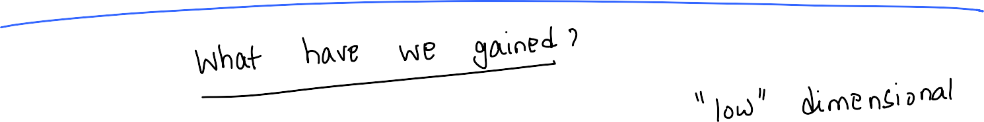









Slide 24

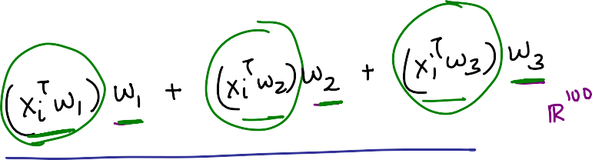











Slide 25














Slide 26
Summary So Far
Algorithm:
Given data {x₁,x₂,…x_{n}}
-> Center data so that mean is 0 (origin shift)
-> Use the “magic” box to find the best line represented by w₁
-> Create dataset with residues
-> Iterate the process to find w₂, w₃, …
Observations:
All the lines obtained from the above process are
orthogonal to each other
The residues must necessarily become 0 after ‘d’ rounds
We gain (compression wise) if residues becomes 0 much earlier
than d rounds.
Question:
What if data lives in an approximately low dimensional space?

Slide 27



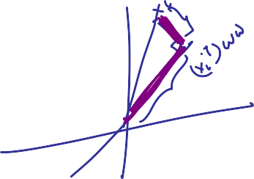











Smaller the value
better the fit
larger the value
better the fit

Slide 28

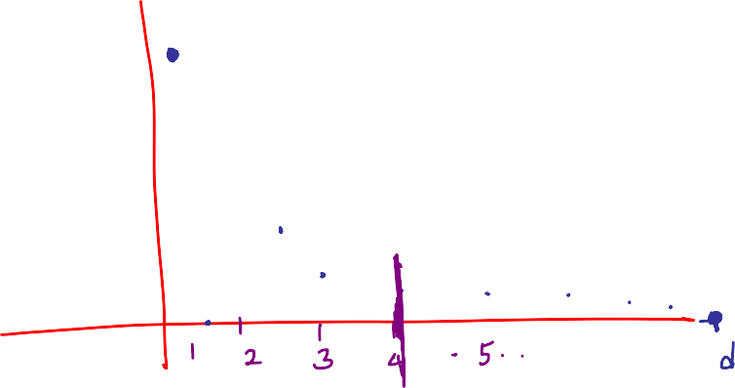







Slide 29















Slide 30
















Slide 31





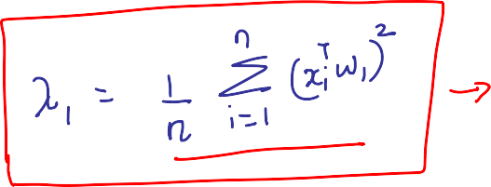





Slide 32






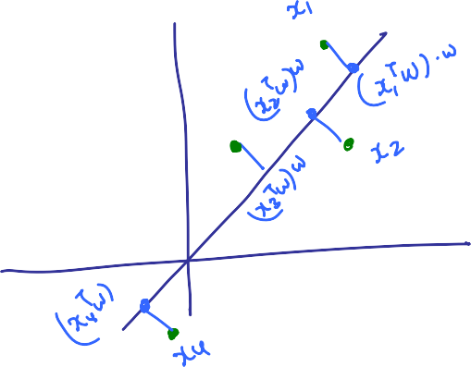



Slide 33







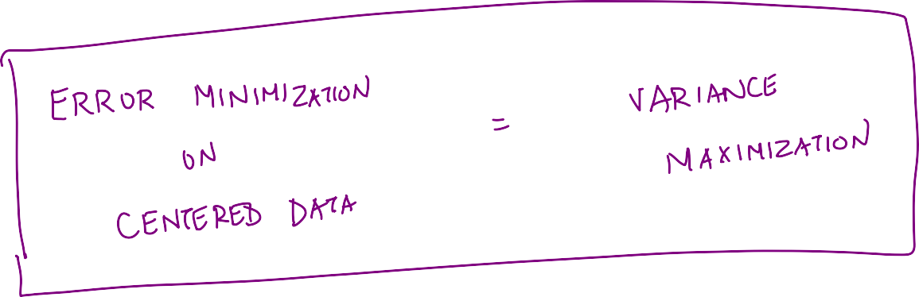

Slide 34



Slide 35



